Slide 1
Cause of Death
Flip Robo technologies

Slide 2
About Dataset
In this Dataset, we have Historical Data of different cause of deaths for all ages around the World. The key features of this Dataset are: Meningitis, Alzheimer's Disease and Other Dementias, Parkinson's Disease, Nutritional Deficiencies, Malaria, Drowning, Interpersonal Violence, Maternal Disorders, HIV/AIDS, Drug Use Disorders, Tuberculosis, Cardiovascular Diseases, Lower Respiratory Infections, Neonatal Disorders, Alcohol Use Disorders, Self-harm, Exposure to Forces of Nature, Diarrheal Diseases, Environmental Heat and Cold Exposure, Neoplasms, Conflict and Terrorism, Diabetes Mellitus, Chronic Kidney Disease, Poisonings, Protein-Energy Malnutrition, Road Injuries, Chronic Respiratory Diseases, Cirrhosis and Other Chronic Liver Diseases, Digestive Diseases, Fire, Heat, and Hot Substances, Acute Hepatitis.

Slide 3
Analysis of Data
For analyse date we use Jupyter Notebook and many libraries such and Pandas, Numpy, for load data and fill data.
For visualization part we use Seaborn and Matplotlib for plot chart and visualize it.

Slide 4
Name of Columns
01. Country/Territory - Name of the Country/Territory
02. Code - Country/Territory Code
03. Year - Year of the Incident
04. Meningitis - No. of People died from Meningitis
05. Alzheimer's Disease and Other Dementias - No. of People died from Alzheimer's Disease and Other Dementias
06. Parkinson's Disease - No. of People died from Parkinson's Disease
07. Nutritional Deficiencies - No. of People died from Nutritional Deficiencies
08. Malaria - No. of People died from Malaria
09. Drowning - No. of People died from Drowning
10. Interpersonal Violence - No. of People died from Interpersonal Violence
11. Maternal Disorders - No. of People died from Maternal Disorders
12. Drug Use Disorders - No. of People died from Drug Use Disorders
13. Tuberculosis - No. of People died from Tuberculosis

Slide 5
14. Cardiovascular Diseases - No. of People died from Cardiovascular Diseases
15. Lower Respiratory Infections - No. of People died from Lower Respiratory Infections
16. Neonatal Disorders - No. of People died from Neonatal Disorders
17. Alcohol Use Disorders - No. of People died from Alcohol Use Disorders
18. Self-harm - No. of People died from Self-harm.
19. Exposure to Forces of Nature - No. of People died from Exposure to Forces of Nature
20. Diarrheal Diseases - No. of People died from Diarrheal Diseases
21. Environmental Heat and Cold Exposure - No. of People died from Environmental Heat and Cold Exposure
22. Neoplasms - No. of People died from Neoplasms
23. Conflict and Terrorism - No. of People died from Conflict and Terrorism
24. Diabetes Mellitus - No. of People died from Diabetes Mellitus
25. Chronic Kidney Disease - No. of People died from Chronic Kidney Disease
26. Poisonings - No. of People died from Poisoning
27. Protein-Energy Malnutrition - No. of People died from Protein-Energy Malnutrition
28. Chronic Respiratory Diseases - No. of People died from Chronic Respiratory Diseases
29. Cirrhosis and Other Chronic Liver Diseases - No. of People died from Cirrhosis and Other Chronic Liver Diseases
30. Digestive Diseases - No. of People died from Digestive Diseases
31. Fire, Heat, and Hot Substances - No. of People died from Fire or Heat or any Hot Substances
32. Acute Hepatitis - No. of People died from Acute Hepatitis

Slide 6
Univariate Analysis

Slide 7
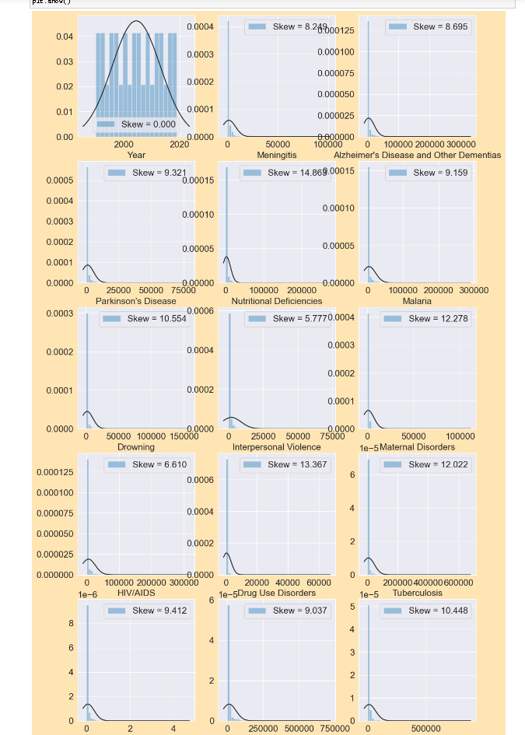
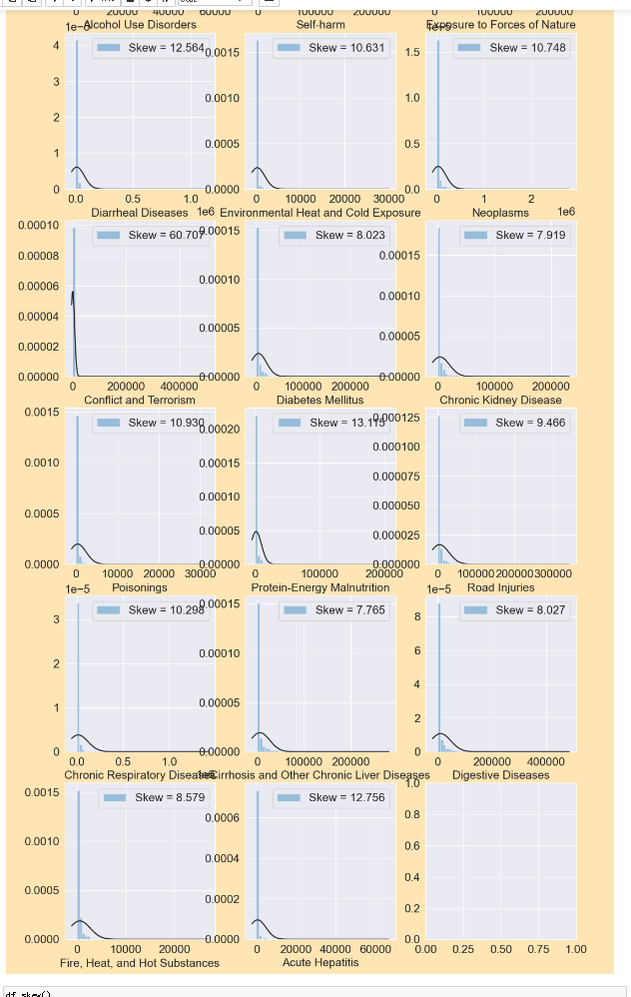

Slide 8
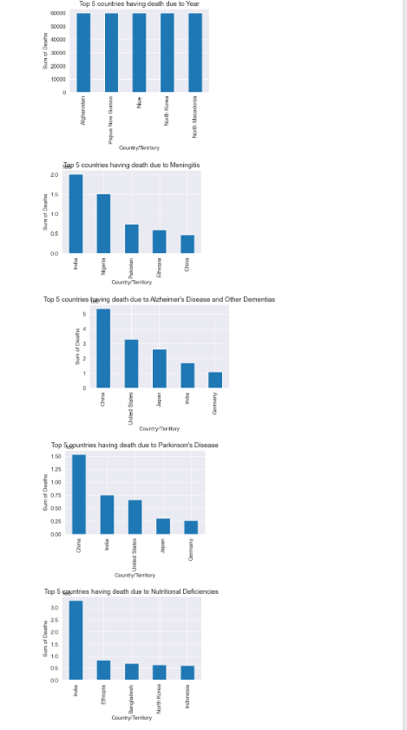
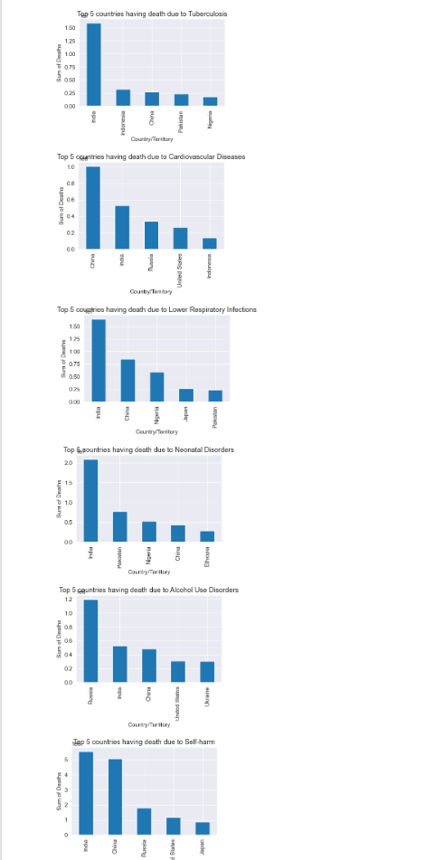
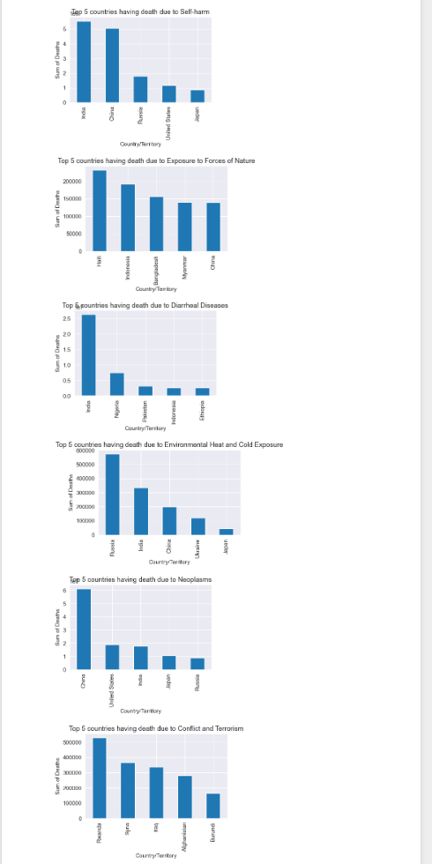

Slide 9
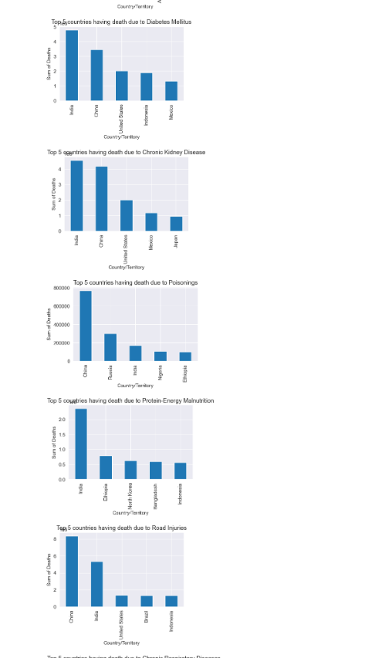
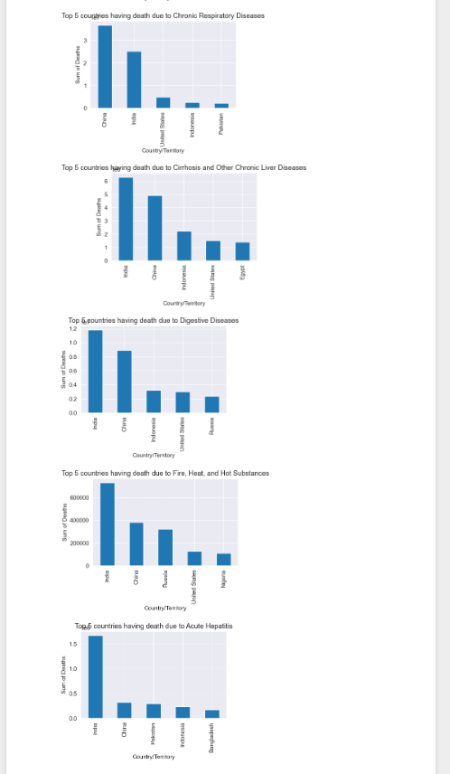

Slide 10
Observations
India---- Meningits, Nutritional Deficiencies, Maternal Disorders, Tuberculosis, Lower Respiratory Infections, Self-harm
Neonatal Disorders,Diarrheal Diseases, Diabetes Mellitus,Choronic kidney,Protein-energy malnutrition,Digestive,Acute Hepatitis
Cirrhosis & other chronic liver, Fire/heat & hot substances
China---- Alzheimer, Parkinson, Drowning, Cardiovascular Diseases, Neoplasms, Poisonings, Road injuries, Chronic respiratory
Nigeria---- Malaria
Brazil---- Interpersonal Violence
South Africa---- HIV/AIDS
USA---- Drug use Disorders
Russia---- Alcohol use Disorders, Environmental Heat&cold exposure
Haiti---- Exposure to forces of nature
Rwanda---- Conflict & Terrorism

Slide 11
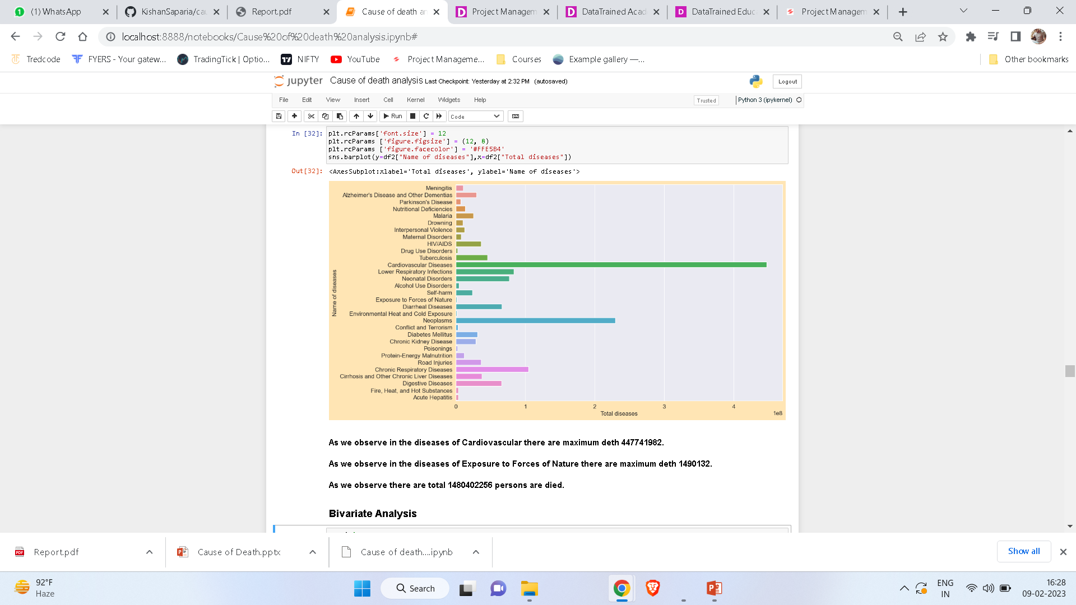

Slide 12
BIVARIATE ANALYSIS

Slide 13
OBSERVATIONS
As we observe in this figure we observe that by increase year the death is decrease in the Meningitis diseases.
As we observe in this figure we observe that by increase year the death is also increase in the Alzheimer's Disease and Other Dementias diseases.
As we observe in this figure we observe that by increase year the death is also increase in the Parkinson's Disease diseases.
As we observe in this figure we observe that by increase year the death is decrease in the Nutritional Deficiencies diseases.
As we observe in this figure we observe that by year this is saturated but in last 4 to 5 years it will decrease the death of Malaria diseases.
As we observe in this figure we observe that by increase year the death is decrease in the Drowning diseases.
As we observe in this figure we observe that this is saturated and also stable in all the years. for Interpersonal Violence diseases death.
As we observe in this figure we observe that by increase year the death is decrease in the Maternal Disorders diseases.
As we observe in this figure we observe that in the year of 2001 to 2008 the death is higher now a days it will decrease by year in the HIV//AIDS diseases.
As we observe in this figure we observe that by increase year the death is also increase in the Drug Use Disorders diseases.
As we observe in this figure we observe that by increase year the death is decrease in the Tuberculosis diseases.
As we observe in this figure we observe that by increase year the death is also increase in the Cardiovascular diseases.
As we observe in this figure we observe that by increase year the death is decrease in the Lower Respiratory Infections diseases.
As we observe in this figure we observe that by increase year the death is decrease in the Neonatal Disorders diseases.
As we observe in this figure we observe that by increase year it will increase but in the year of 2004 and 2005 Alcohol Use Disorders diseases is high.

Slide 14
As we observe in this figure we observe that by increase year the death is decrease in the Diarrheal diseases.
As we observe in this figure we observe that this is saturated and also stable in all the years. for Environmental Heat and Cold Exposure diseases death.
As we observe in this figure we observe that by increase year the death is also increase in the Neoplasms diseases.
As we observe for Conflict and Terrorism there are only the year of 1994,2014 it was higher.
As we observe in this figure we observe that by increase year the death is also increase in the Diabetes Mellitus diseases.
As we observe in this figure we observe that by increase year the death is also increase in the Chronic Kidney Disease diseases.
As we observe in this figure we observe that this is saturated and also stable in all the years. for Poisonings diseases death.
As we observe in this figure we observe that by increase year the death is decrease in the Protein-Energy Malnutrition diseases.
As we observe in this figure we observe that this is saturated and also stable in all the years. for Road Injuries diseases death.
As we observe in this figure we observe that by increase year the death is also increase in the Chronic Respiratory diseases.
As we observe in this figure we observe that by increase year the death is also increase in the Cirrhosis and Other Chronic Liver diseases.
As we observe in this figure we observe that by increase year the death is also increase in the Digestive diseases.
As we observe in this figure we observe that this is saturated and also stable in all the years. for Fire, Heat, and Hot Substances diseases death.
As we observe in this figure we observe that by increase year the death is decrease in the Acute Hepatitis diseases.
As we observe in this figure we observe that this is saturated and also stable in all the years. for Self-harm diseases death.
As we observe for Exposure to Forces of Nature death there are only the year of 1990,1991,2004,2008,2010 it was higher.

Slide 15
